Slide 1

Standard Operating Procedure For FO Team
Company: Favelin
FO Team Leader Hanen Mohamed 2 - Fab - 2026

Slide 2

Fo Team
The FO team stands for Front Office Team. Its main responsibilities divided into two sections: Chats and Calls.
The chat section: handles social media platforms for Favelin, including Facebook, Instagram,
TikTok, as well as live chat through the Tawk :
Comments : We also respond to customer comments posted on social media. Depending on the situation, we either reply publicly or reach out privately to address all customer inquiries.
The calls section:includes phone calls for order confirmation, collecting customer feedback, Field delivery follow-ups, Failed payment and handling cases where the customer prefers phone communication instead of chat.
2

Slide 3
Order Status Flow:
Pending – Order is received from the website or created by CX team
Processing – Order is sent to the warehouse for preparation.
Shipment Created – Order is ready for pickup by the shipping company and tracking number has been created
Shipped – Shipping company has collected the order.
Delivered – Customer has successfully received the order.
Failed Delivery –It is returned to the warehouse.

Slide 4

Order Confirmation Process Overview
what is confirmation
Pending orders confirmation methods:
1-SMS confirmation: Some pending orders are automatically confirmed via an SMS sent to the customer.
2-System auto-confirmation: Orders from trusted customers can be automatically confirmed by the system without manual intervention.
3-Customer Experience (CX) team: For other cases, the CX team manually confirms pending orders.

Slide 5
Order Confirmation Process by CX
Prepare – Open the system and verify customer data and order number.
Call – Contact the customer, confirm order details, delivery, and answer questions.
Action – Take any required actions based on the call.
Documentation – Record the call details and actions taken.

Slide 6
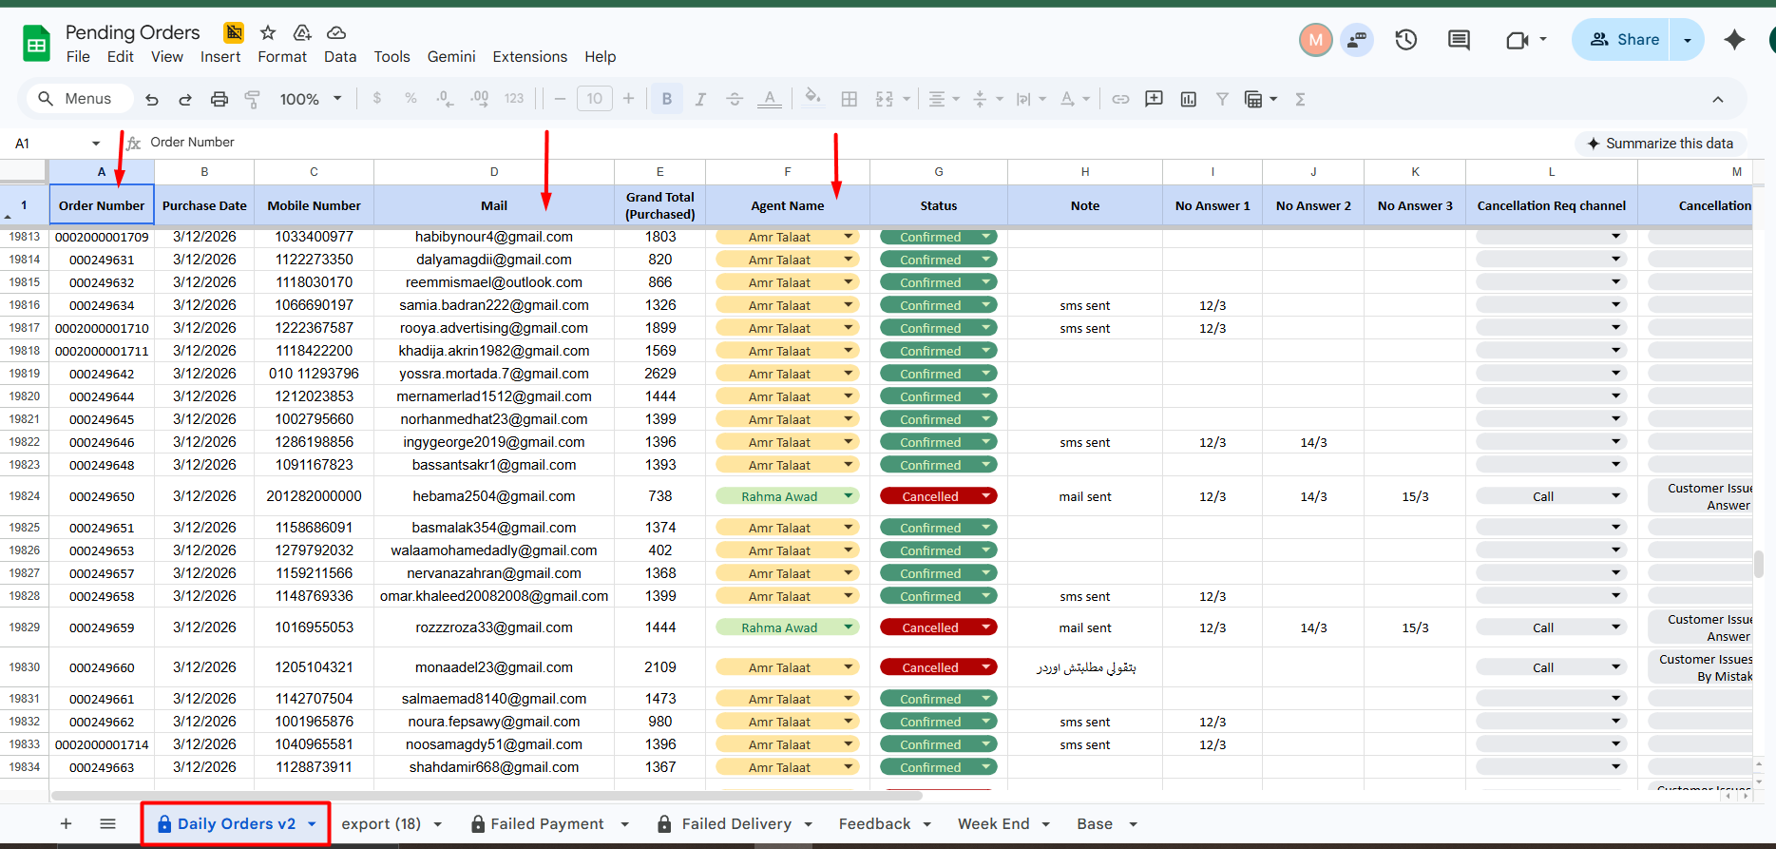
1. Preparation:
Open the orders sheet and review the orders assigned by name.
https://docs.google.com/spreadsheets/d/1WpW54clQs2pp8qb_L88BnWLhwtp0381DyOfcsBJmwgY/edit?gid=489779968#gid=489779968
Select the customer email to verify the order number and ensure the customer has no other pending orders.

Slide 7
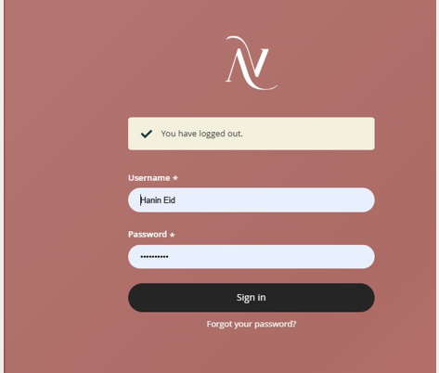
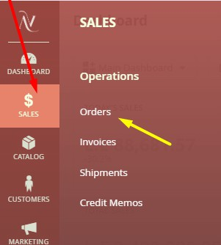
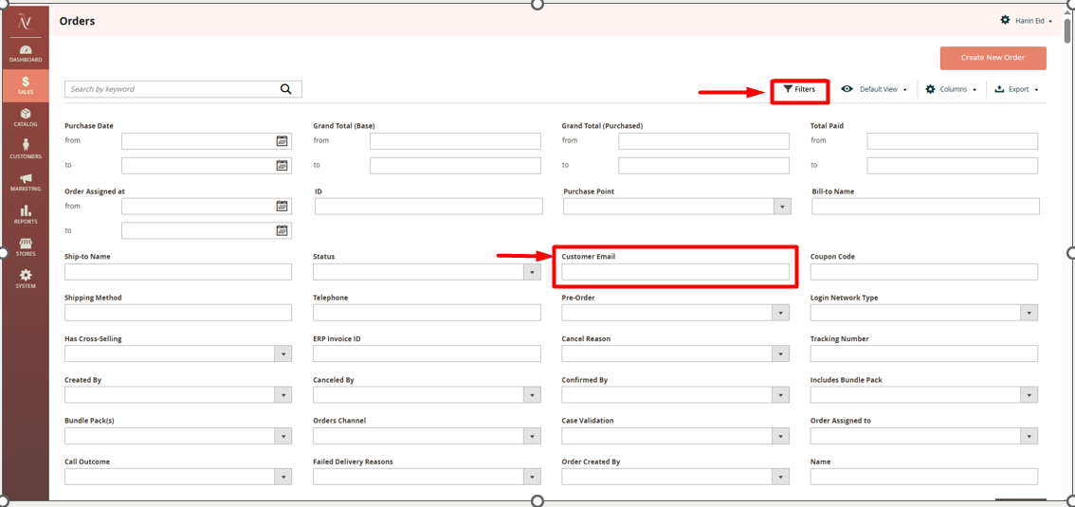
1. Preparation:
Log in to Magento using your credentials.
https://favelin.com/admin
Go to Sales → Orders, click Filter, and paste the customer email in the customer email box.
Open the relevant order and ensure all required data is complete and accurate.

Slide 8
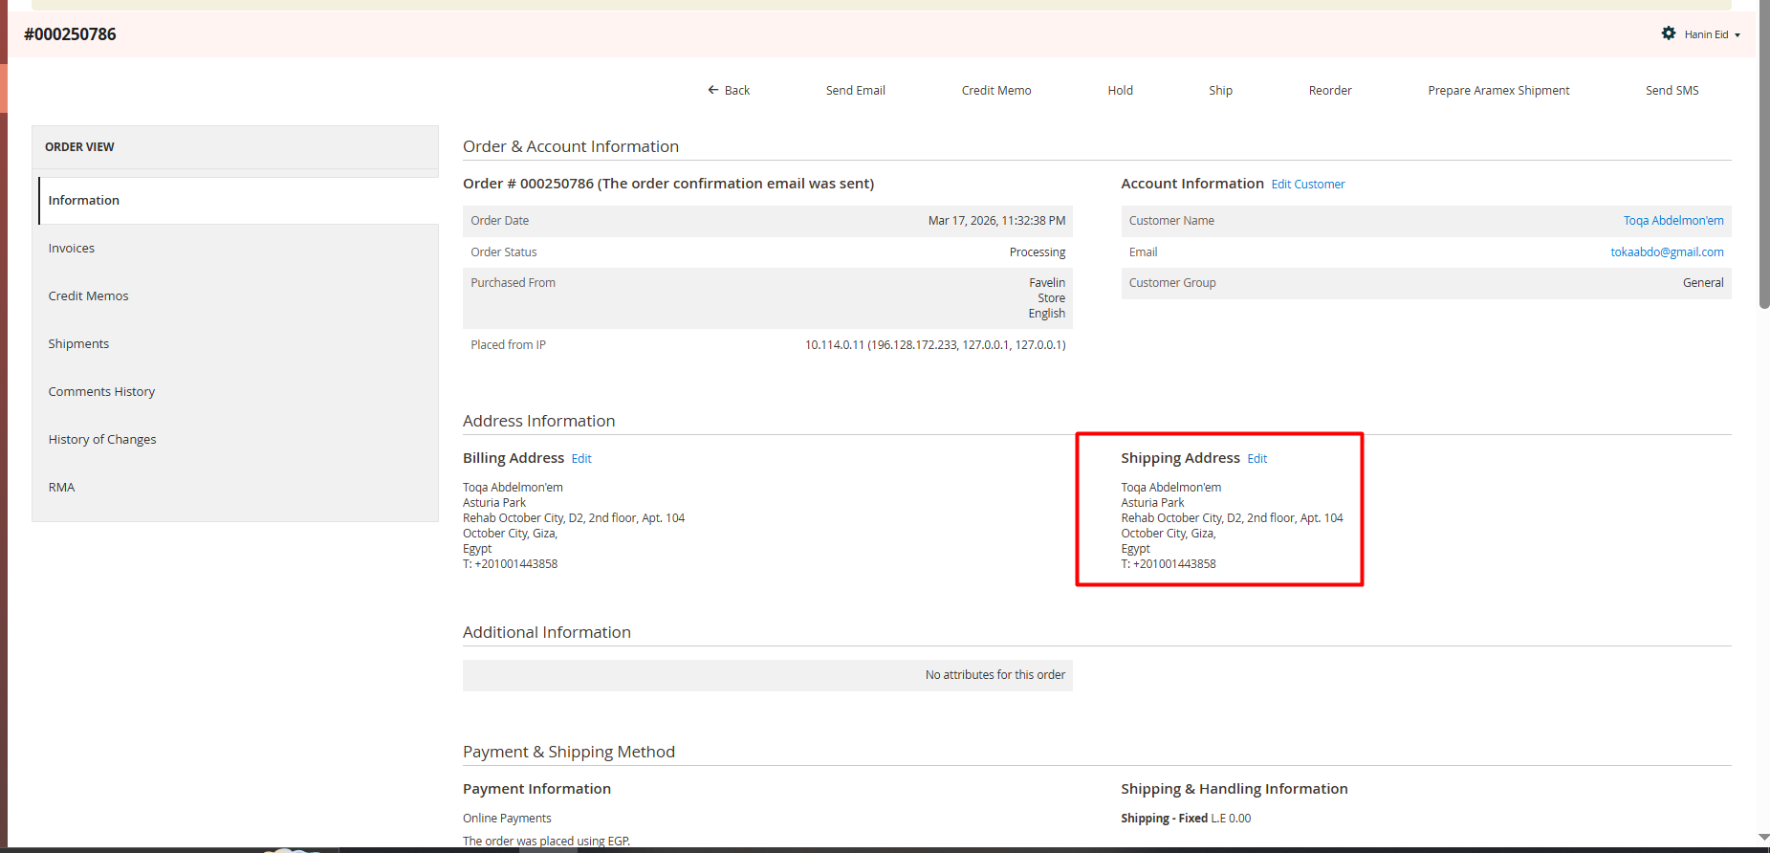
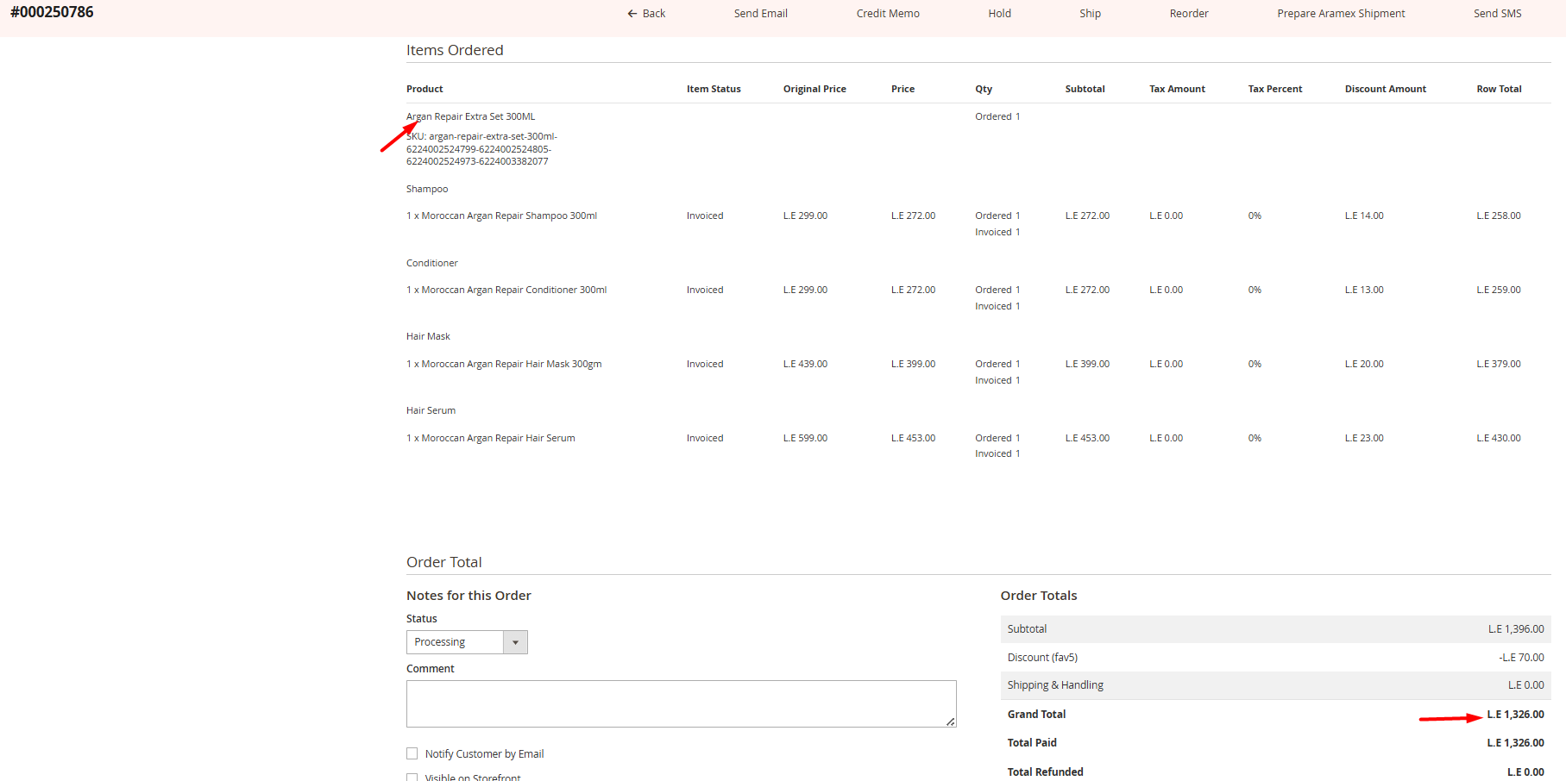
2-Order Confirmation Call Procedure
Greeting & Introduction: Begin the call with a polite greeting. Introduce yourself and mention that you are calling on behalf of the Favelin brand.
Order Confirmation: Confirm the customer’s order details, including the products, total price (after any discount code), and applicable shipping fees.
Address Verification: Verify the delivery address with the customer to ensure accuracy.
Delivery Information: Inform the customer that delivery will occur within 3–5 business days. Explain that the courier will contact them directly to coordinate the delivery.
Closure & Assistance: Ask the customer if they require any further assistance. End the call courteously by wishing them a pleasant day.

Slide 9
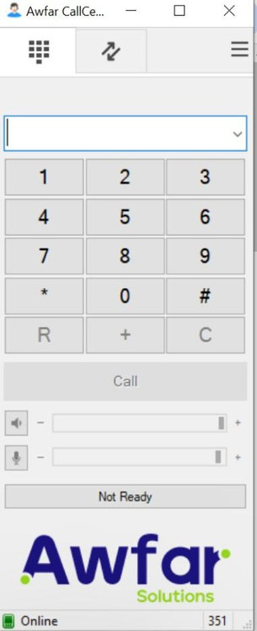
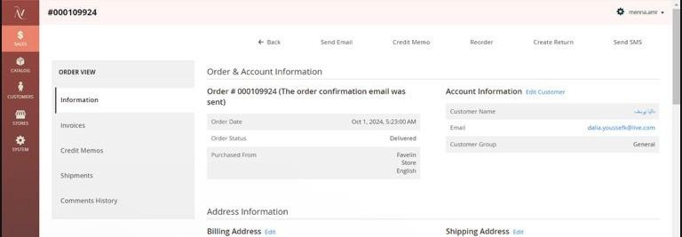
Tools and system used
Awfar cc:calling system used to contact customers
Magento:used to open and review cutomer and order deatails
4

Slide 10
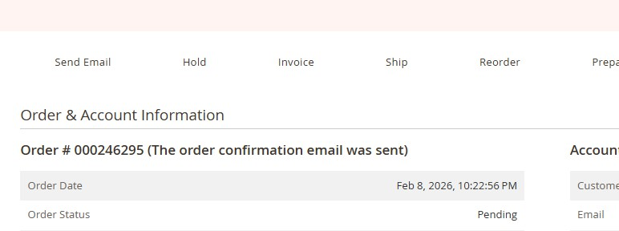

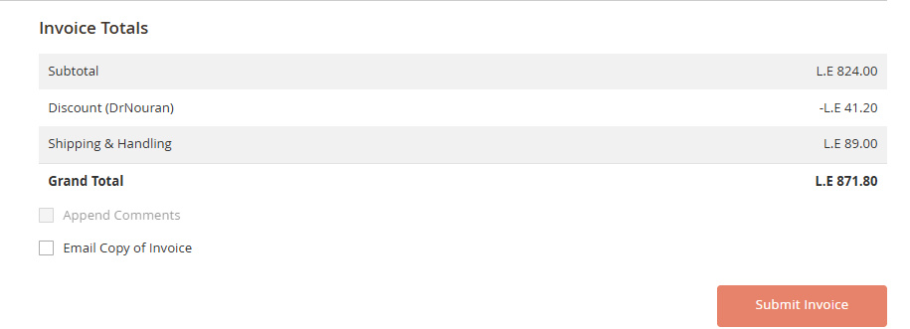
3-Action Taken after call
1-If the customer confirmed the order
If the order is confirmed click “Invoice”
Then order status is updated to processing

Slide 11
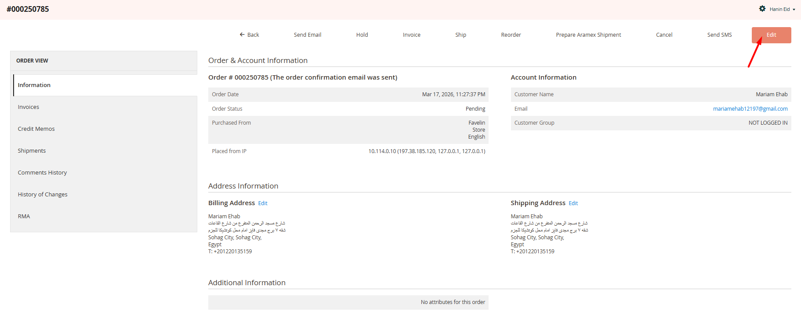
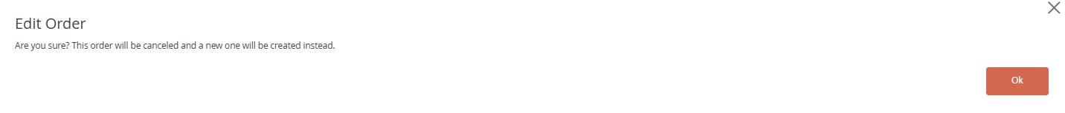
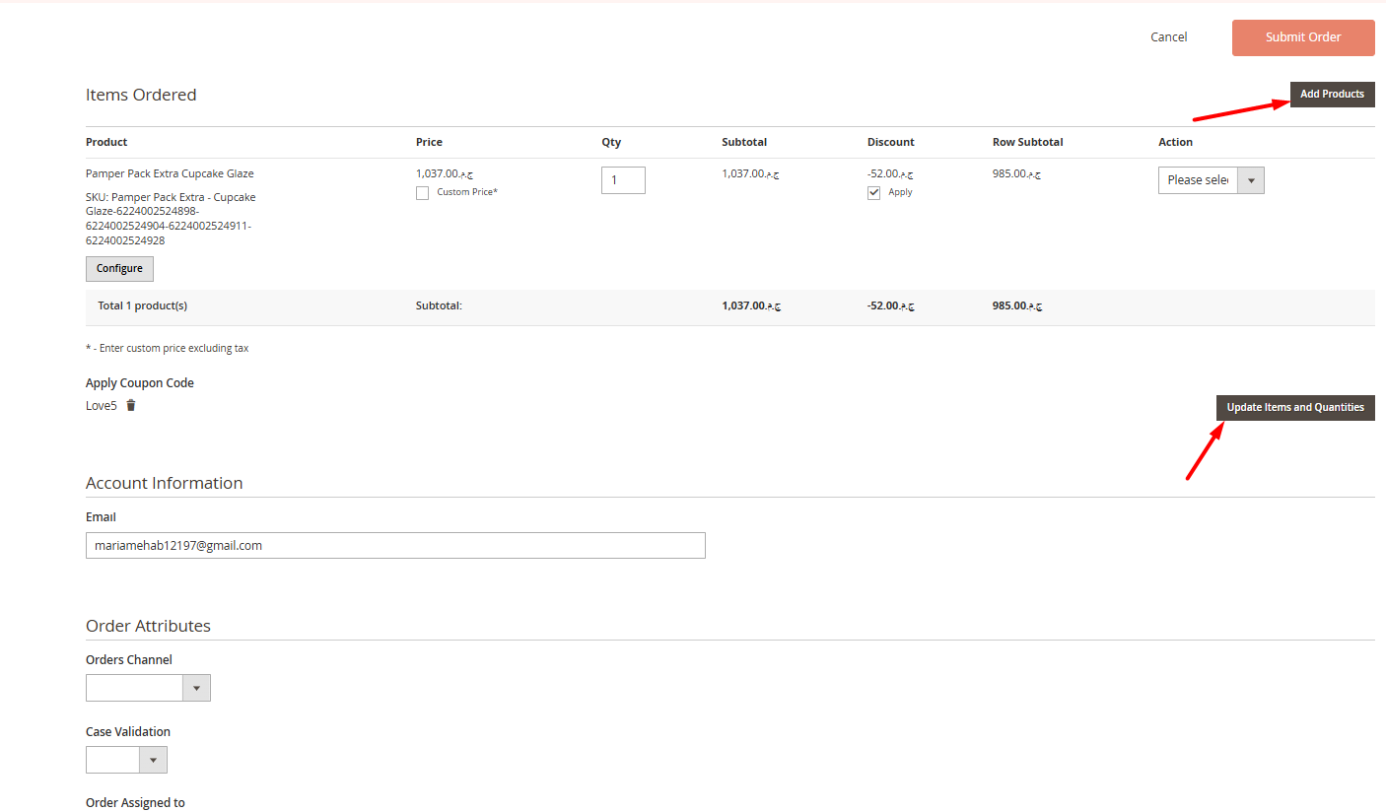
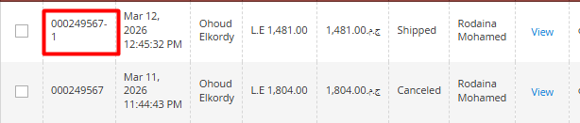
3-Action Taken after call
2-If the customer edited the order
Click the “Edit” button at the bottom of the page to start editing the order.
The current order will be automatically canceled.
A new order will be created with the same products and customer details.
Modify the order as needed:
Add new products
Remove existing products
Update product quantities or details
Submit the updated order once changes are complete.
The revised order will be saved with the same original Order ID, with a suffix (-1) to indicate it is an updated version.

Slide 12

Order cancellation actions
3-Action Taken after call
3-If the customer cancelled the order
If the order status is processing we creat a credit memo on the system
If the order status is pending canceled directly from the
system and choose the reason of cancellation.
If the Order status is shipment created
we send mail to delivery success team requesting order cancellation
If the Order status is shippied we submit a cancellation
request through the DS form

Slide 13
Cancellation Reasons
Customer Issues
Product Issues
Operations Issues
Changed Mind.
Found Better Deal Elsewhere.
Financial Reasons.
Personal Emergency.
Customer Service Experience.
Wrong Product Ordered.
Duplicate Order.
Refuse to Mention.
No Answer.
Wrong Phone number.
Change Payment Term.
Quality Concerns.
Lack of Information.
Concerns About Ingredients.
Fulfillment Delays.
Technical Issues.
Stock Issues.
Confirmation issue.
Uncovered Delivery Area.
Late Delivery.

Slide 14
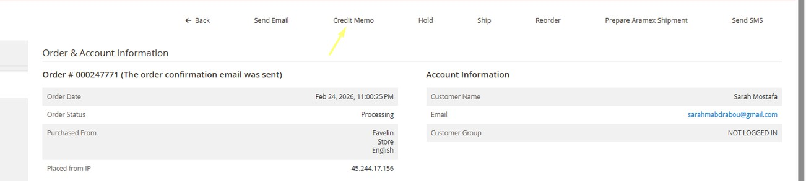
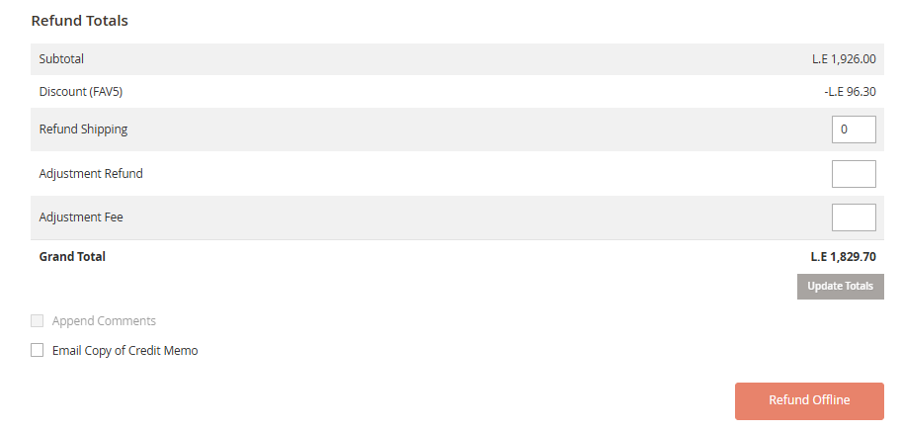
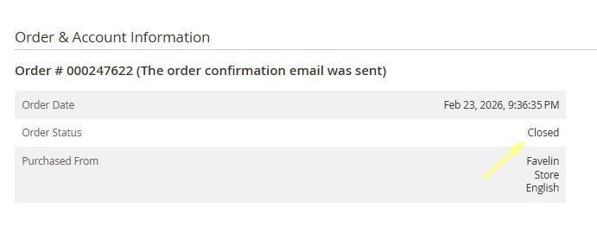
For Processing order that we need to cancel, we select Credit Memo, then choose Credit Memo Offline.
3-Action Taken after call
- The order status will change from Processing to Closed.

Slide 15
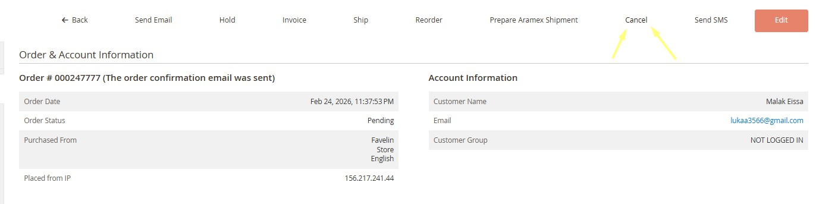
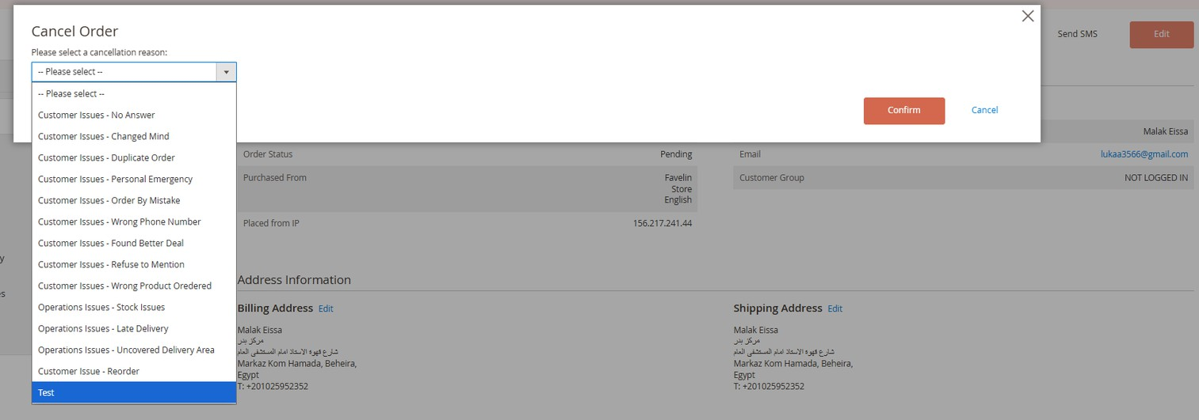
For Pending orders , we select Cancel from the options, then a dropdown menu will appear where we choose the cancellation reason.
3-Action Taken after call

Slide 16
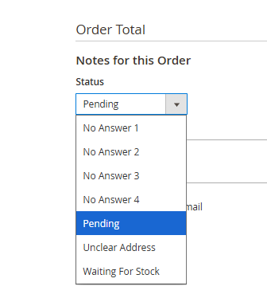
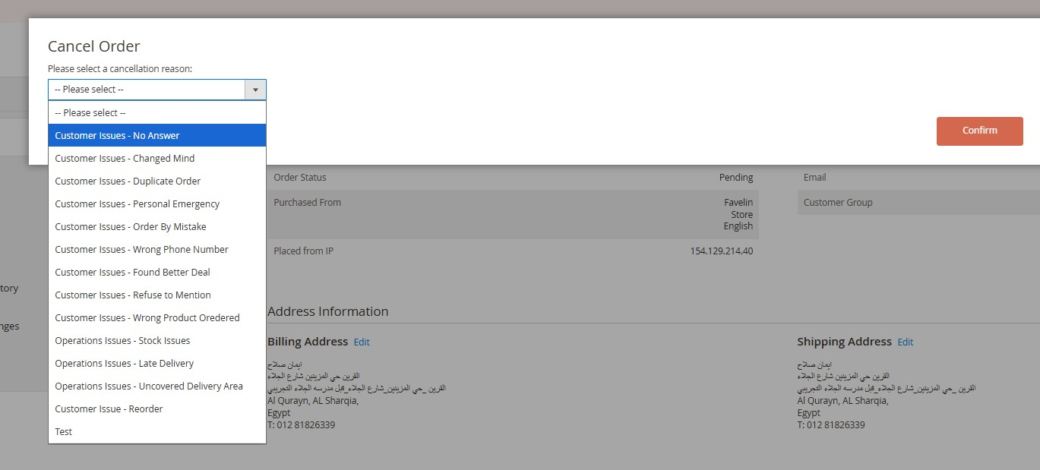
No answer process
3-Action Taken after call
4-if the customer is unreachable
First Attempt: Call the customer. If there is no answer, send an SMS.
عزيزى العميل , حاولنا التواصل معك بتأكيد طلبك ولكن لم نتمكن من الوصول اليك.يرجى التواصل معنا حتى نتمكن من تجهيز وتوصيل طلبك فى اقرب وقت ممكن
Second Attempt: Call the customer again. If there is still no answer, send a no answer email.
Third Attempt: Call the customer once more. If there is still no response, send a reminder.
Final Step: If there is no response by the end of the day, cancel the order.
Note: The cancellation reason will be No answer - Phone call

Slide 17
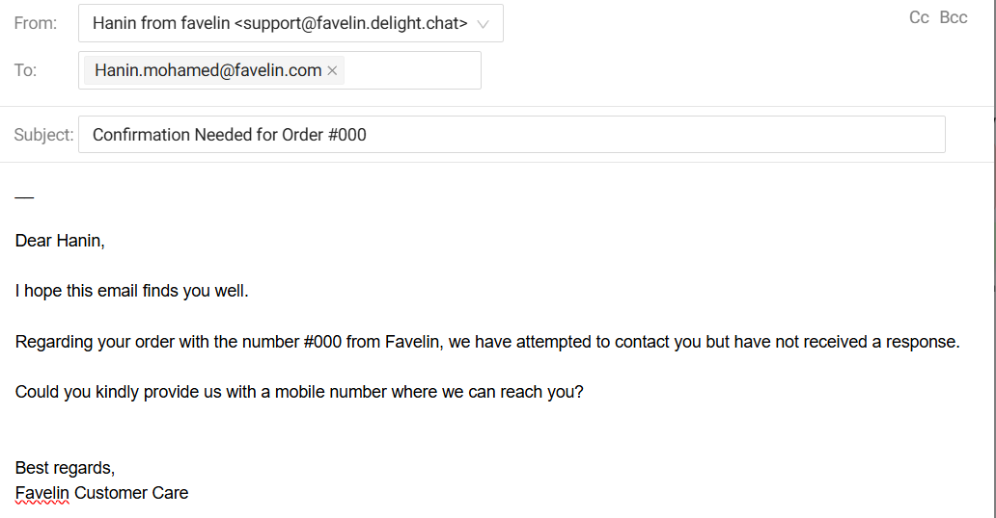
Email action and wrong number
3-Action Taken after call
Such emails are sent when we are unable to reach the customer after call attempts, and an SMS has already been sent with no response.
Email subject: “Confirmation Needed for Order #000”. After choosing no answer template.

Slide 18
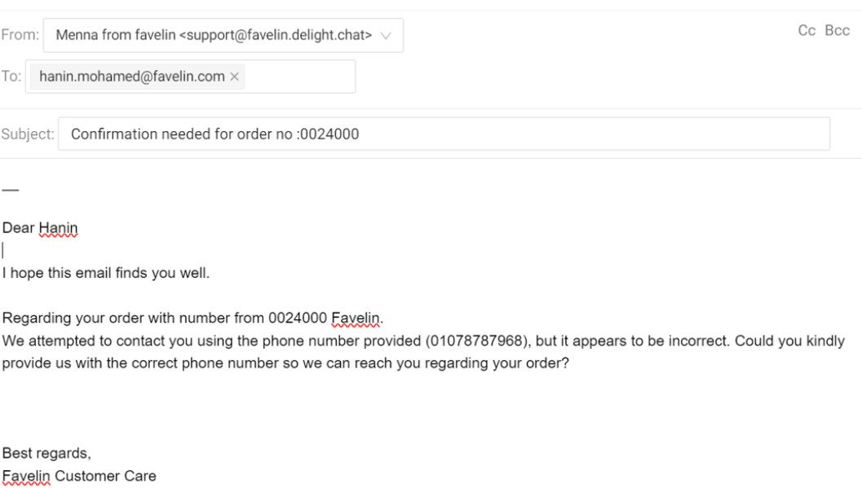
No answer & Wrong number E-mail
3-Action Taken after call
Such emails are sent when the phone number provided in the order is incorrect.
Send email with subject: then we choose wrong number template.
If no reply, cancel the order.

Slide 19
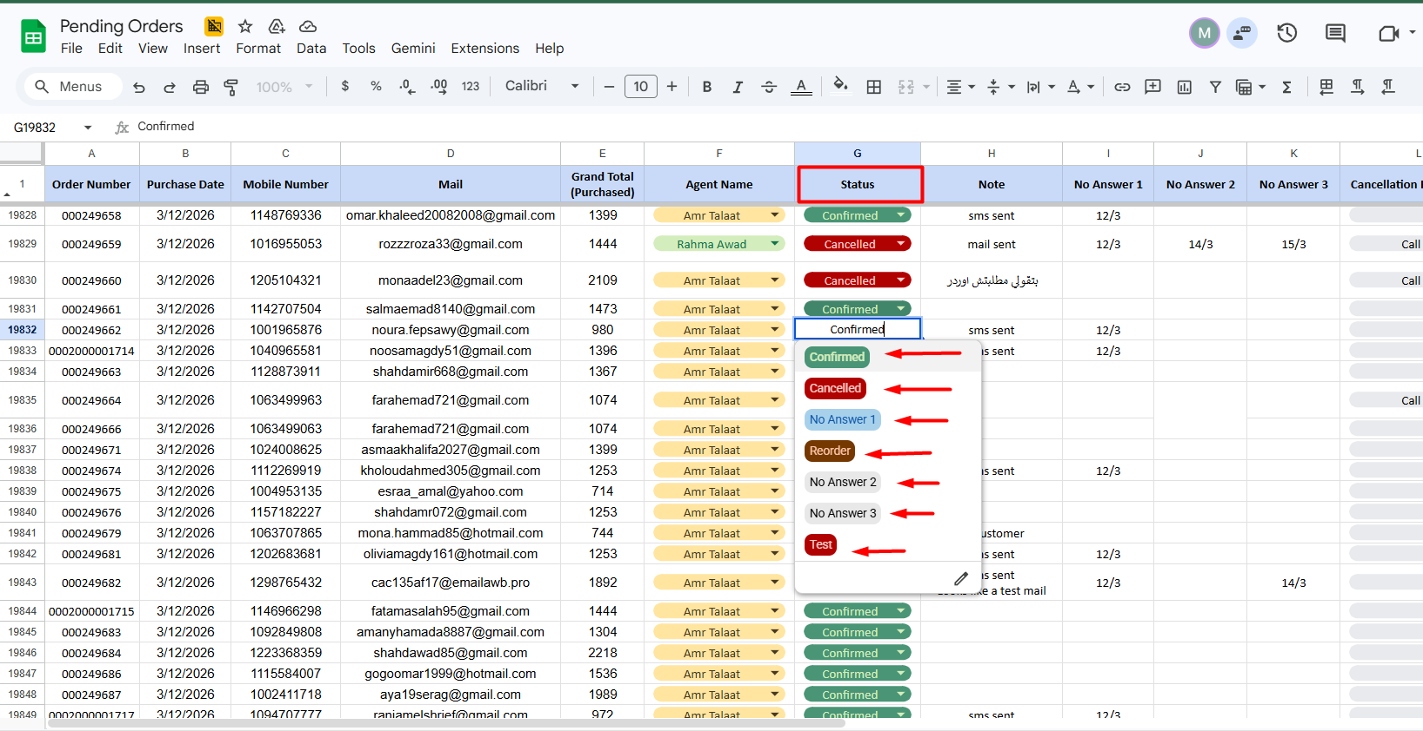
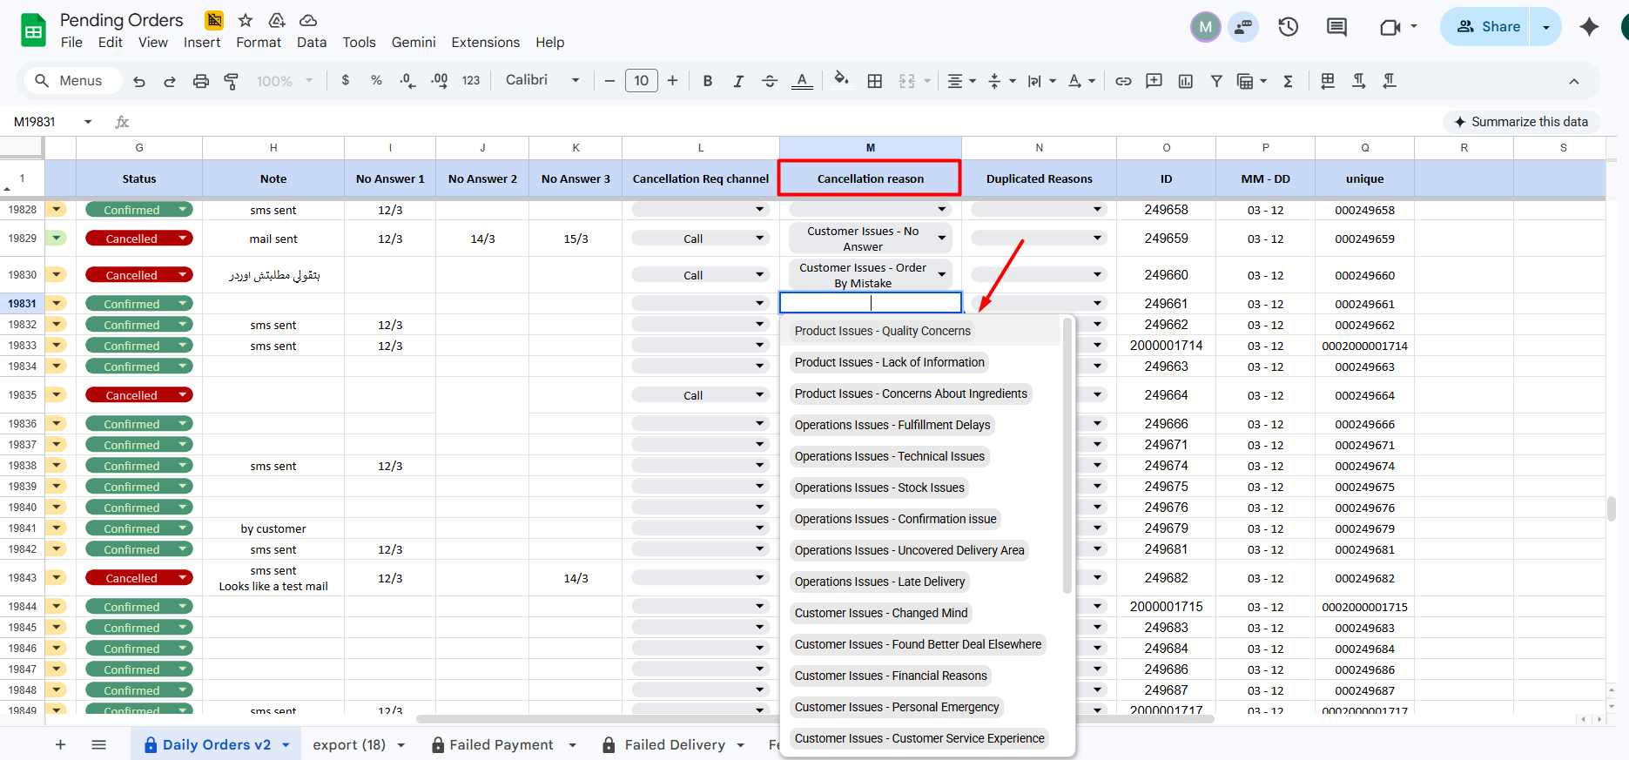
4-Documentation
We document every step taken on Magento in the pending sheet as follows:
If the customer confirms: Select Confirmed as the status.
If the customer requests edits: Create a Re-order, mention the new order number, and select the cancellation reason as Duplicate.
If the customer cancels: Select Cancelled and document the cancellation reason.
If the customer is unreachable: Record each call attempt as No Answer 1, No Answer 2, and No Answer 3.

Slide 20

Customer Feedback Collection
The Aim: Our primary goal is to identify pain points in the customer journey and proactively resolve them. By listening to our customers, we can address individual issues immediately and implement long-term improvements to ensure every Favelin customer enjoys a seamless, premium experience.

Slide 21
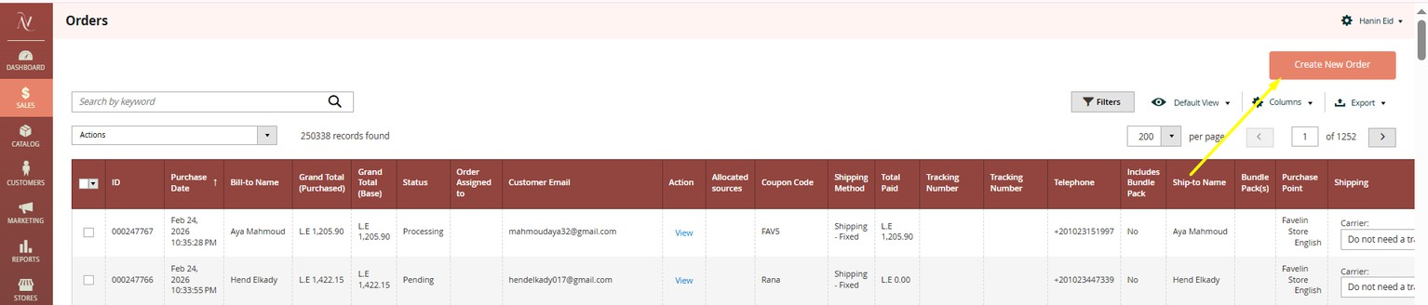
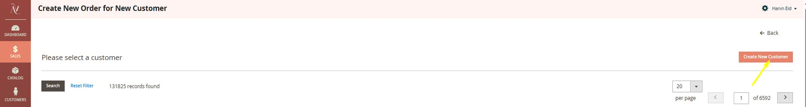
You can place the order from magento system
- From create a new order
- If the customer is new, you select Create New Customer.

Slide 22
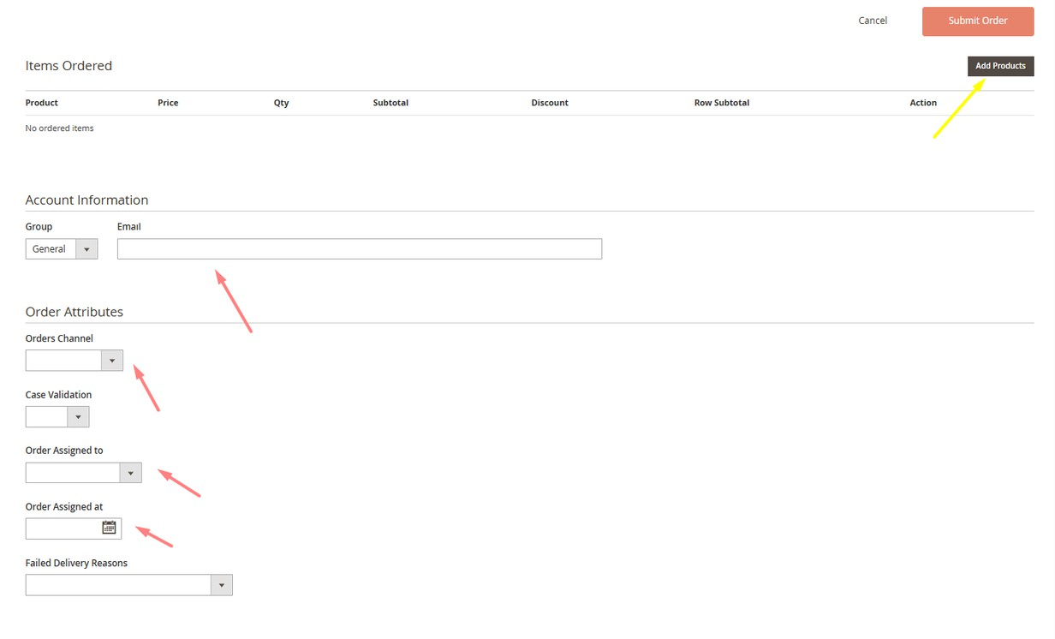
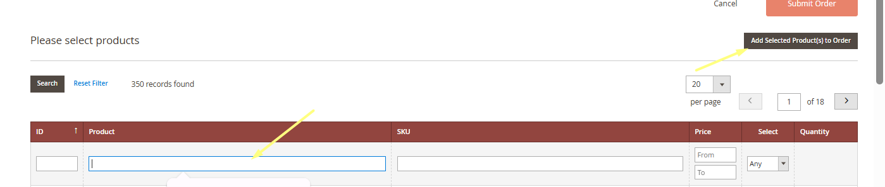
- You select the products you want to place the order with by clicking Add Product, then fill in the customer’s details and assign the order under your name, including the date and the channel it was made from.

Slide 23
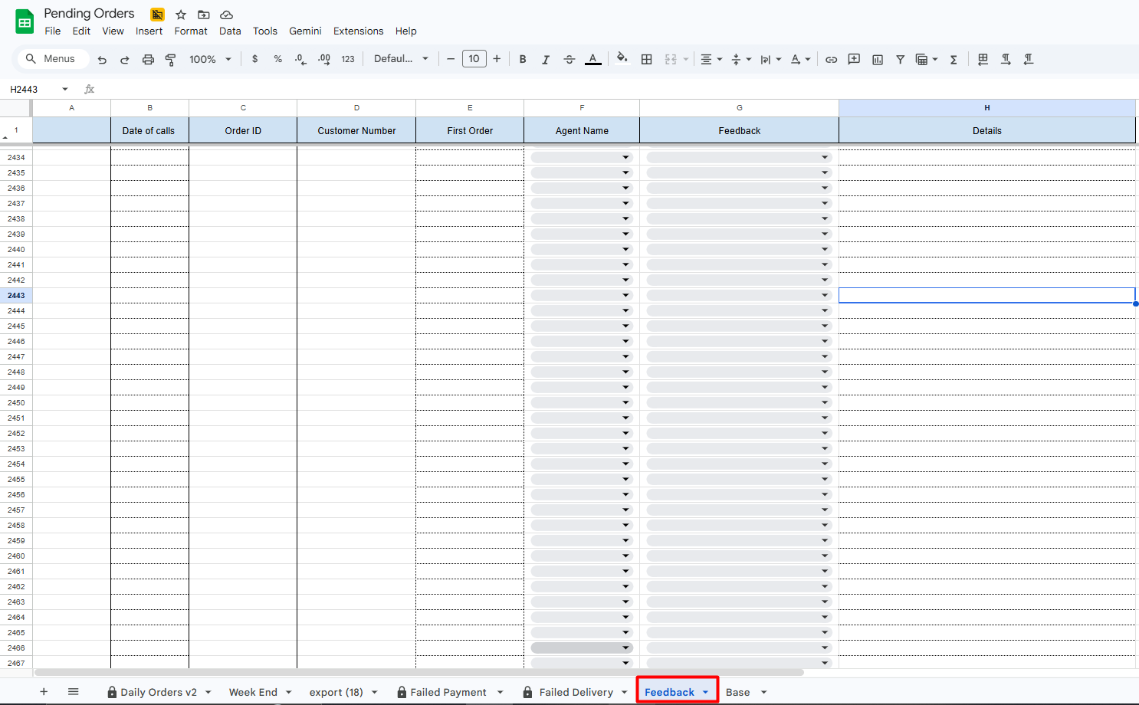
1-Preparation
Access Magento: Open the specific order record to identify the customer’s name, the exact products purchased.
Data Entry: Ensure your feedback sheet is open from social media data base sheet , click Feedback tap and review the orders assigned by name.
https://docs.google.com/spreadsheets/d/1WpW54clQs2pp8qb_L88BnWLhwtp0381DyOfcsBJmwgY/edit?gid=2099490814#gid=2099490814

Slide 24
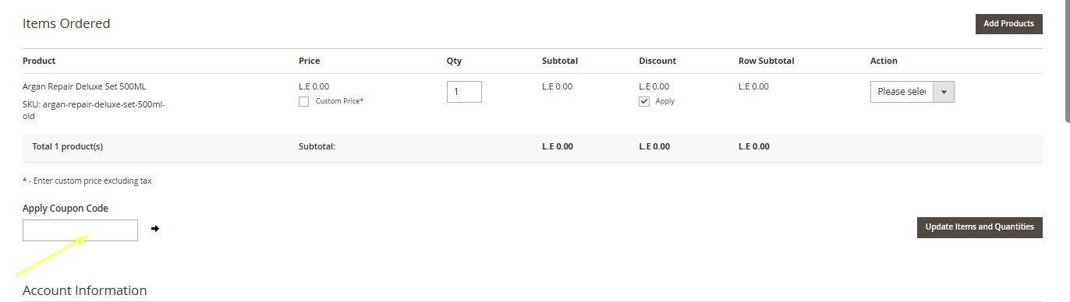
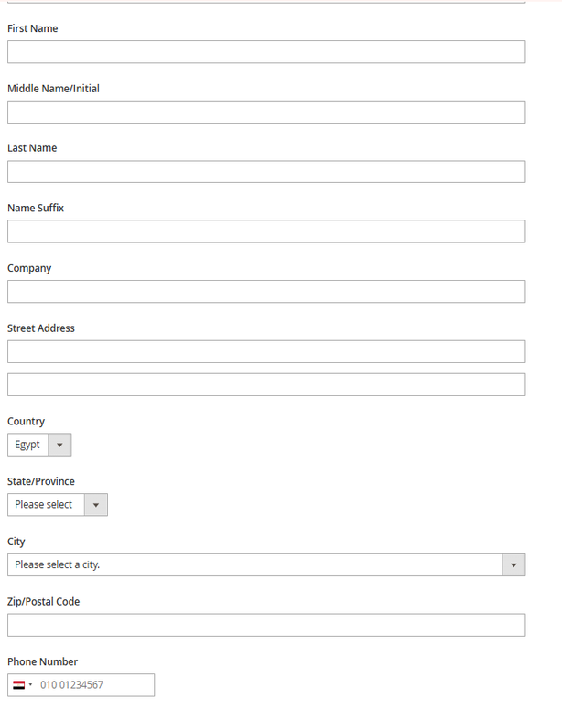
- If there is a discount code, you enter it in the designated discount code field, then click the arrow next to it to update the product price after activating the discount code.
- After that, we fill in the customer’s details.

Slide 25
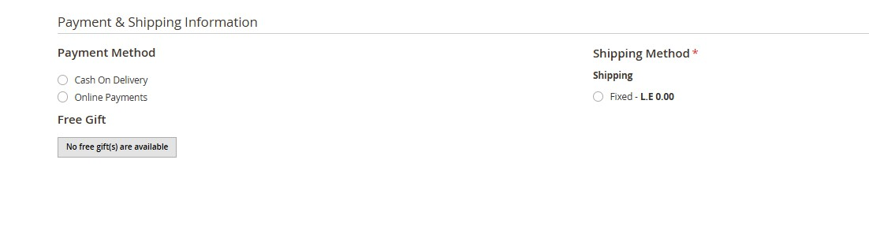
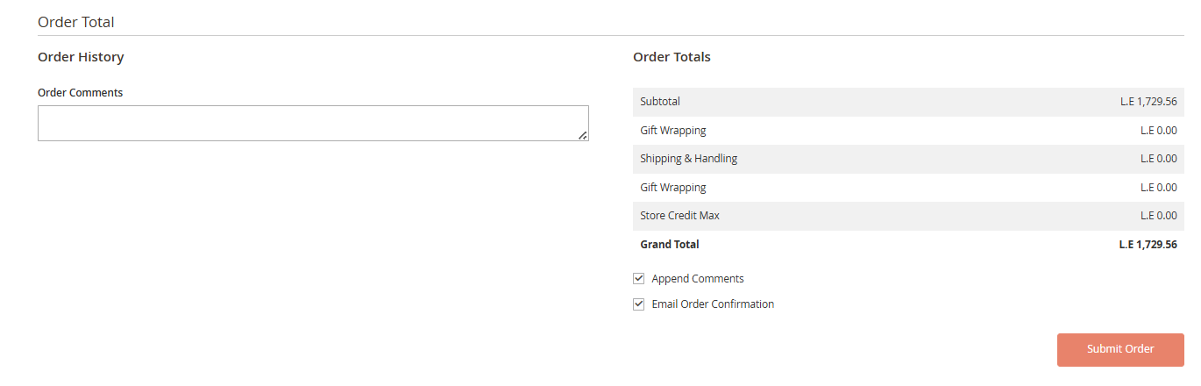
- You choose the payment method: Cash on Delivery or Online Payment (Don’t select this option if you’re the ones placing the order), and then you select the shipping fees.
- After entering all the details and the products the customer needs, we submit the order.

Slide 26
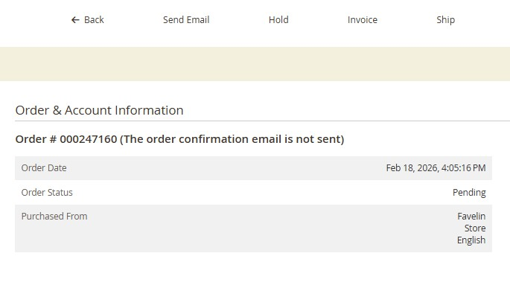
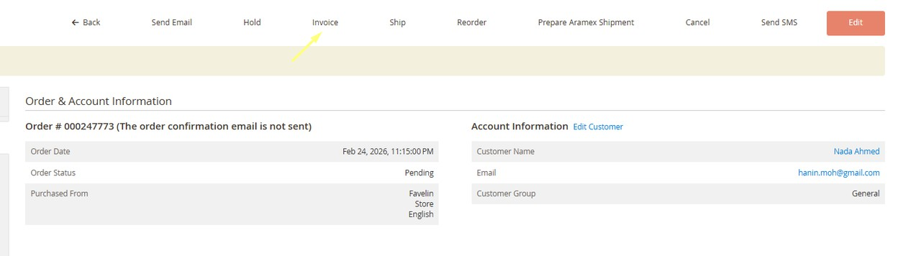
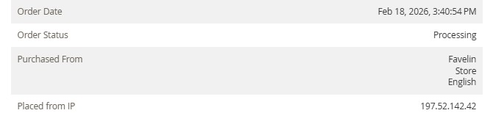
- After clicking Submit Order, the order is registered in the system and its status becomes Pending.
- You select Invoice to confirm the order, Its status will change from Pending to Processing.

Slide 27
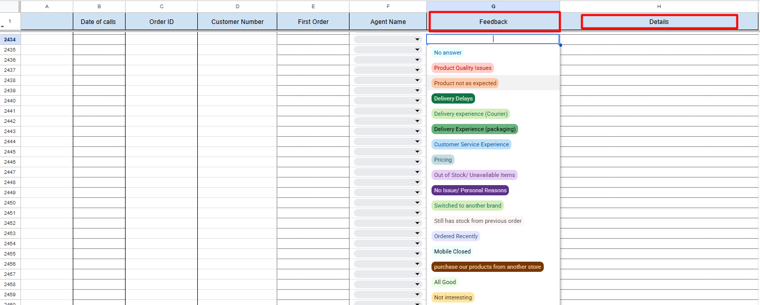
2-The Call Script
Greeting:
"مساء/صباح الخير أ/ ... مع حضرتك (الاسم) من Favelin
Product Quality: هل المنتجات كانت فعالة ومناسبة مع حضرتك ؟
Packaging: هل الاوردر وصل لحضرتك متغلف وفي حالة جيدة؟
Delivery & Courier: هل الاوردر وصل في خلال الوقت اللي حضرتك اتبلغتي بيه او حصل اي تأخير؟
3- Documentation on sheet
Based on the customer's response, categorize the feedback on the sheet using the following logic and clarify any other details on column details

Slide 28
Record the selected feedback in the ‘Feedback’ field
No Answer:
Selected when the customer does not answer the call
Product Not as Expected:
Selected when the product doesn't meet the customer's expectations.
Product Quality Issues:
Selected when the customer reports an issue with product quality (damaged, poor quality, or defective).
Delivery Delays:
Selected when the delivery is delayed beyond the expected time (3-5 working days)
Delivery Experience (Courier):
Selected when the issue is related to the courier's behavior or handling.
Delivery Experience (packaging):
Selected when the packaging is damaged, poor, or not suitable.

Slide 29
Record the selected feedback in the ‘Feedback’ column
Customer Service Experience:
Selected when the feedback is related to customer service experience.
Pricing
Selected when the customer is not satisfied with the price.
No Issue/ Personal Reasons:
Selected when there is no issue and the reason is personal.
Out of Stock/ Unavailable Items:
Selected when the item is out of stock or unavailable.
Switched to another brand:
You can describe the topic of the section elected when the customer states they switched to another brandhere.

Slide 30
Failed Delivery calls
Core Objective:
The primary goal of Faild Delivery calls is to proactively engage with customers whose orders encountered delivery issues. By establishing direct communication, we aim to:
Minimize Return Rates: Prevent orders from being returned to the warehouse due to delivery failure or lack of communication.
Prioritize Prepaid Orders: Ensure that customers who have already paid receive their items promptly to maintain trust.
Facilitate Re-ordering: Efficiently process re-orders when necessary to ensure successful delivery on the second attempt.
Customer Retention: Our objective is to prevent business loss and maintain long-term loyalty through high-touch service recovery. We aim for a 50% re-order success rate by incentivizing customers with the 'WECARE10' promo code, offering a 10% discount to encourage them to complete their purchase.

Slide 31
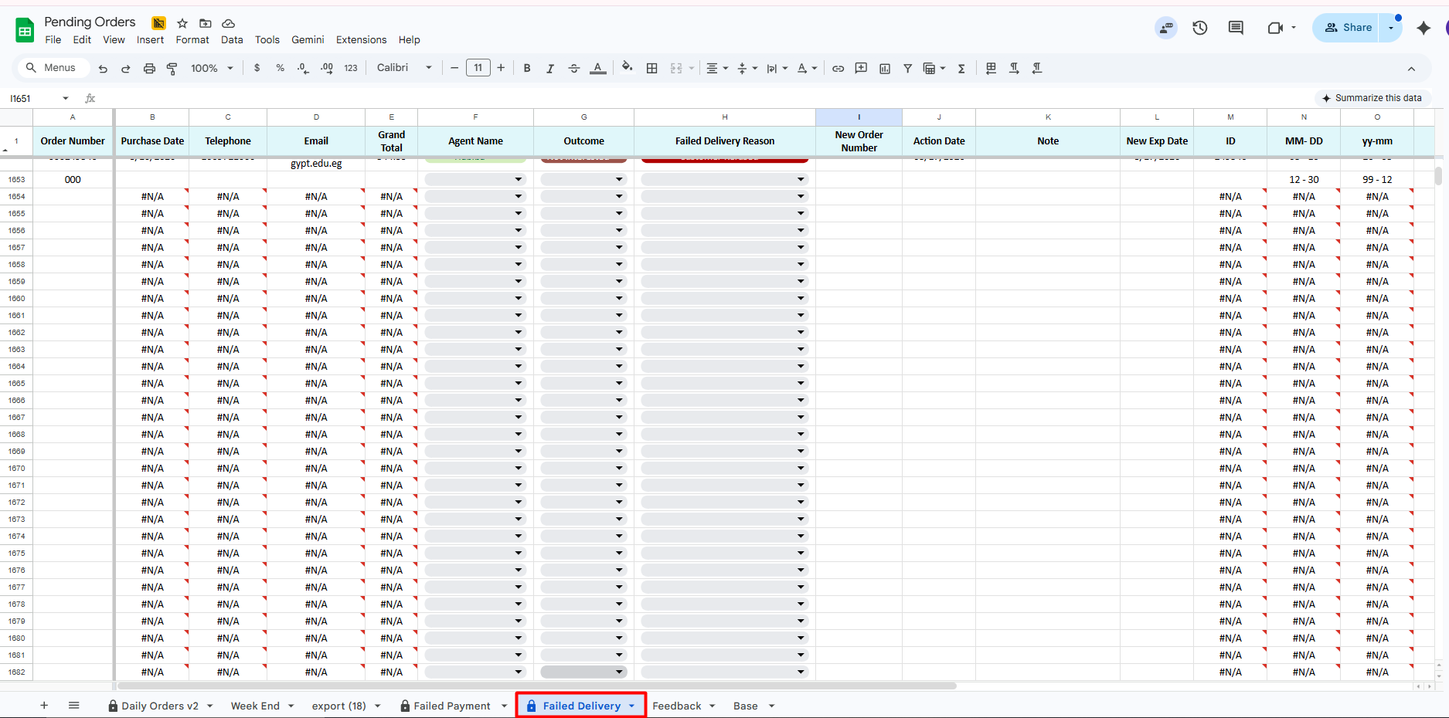
1-Preparation
Access Magento: Open the specific order record to identify the customer’s name, if there any additional order for the same customer.
Data Entry: Ensure your Failed Delivery sheet is open from social media data base sheet , click Failed Delivery sheet tap and review the orders assigned by name.
https://docs.google.com/spreadsheets/d/1WpW54clQs2pp8qb_L88BnWLhwtp0381DyOfcsBJmwgY/edit?gid=1195143614#gid=1195143614

Slide 32
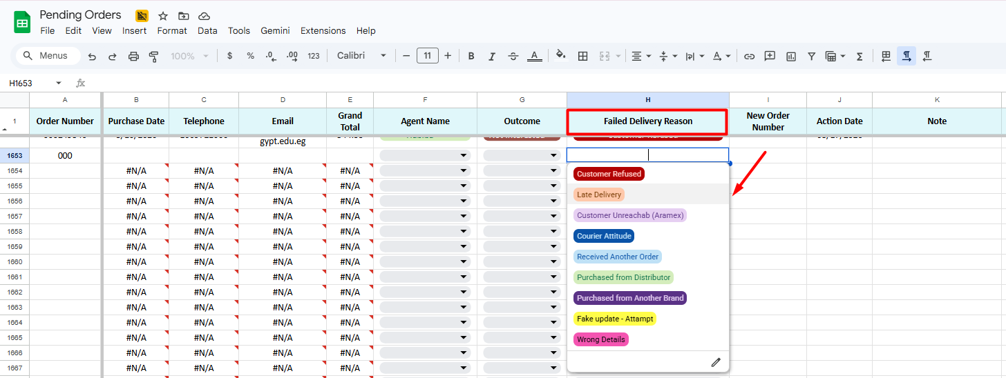
2-The Call Script
صباح/ مساء الخير أ/ ...
مع حضرتك ( الأسم ) من Favelin بتواصل مع حضرتك بخصوص اخر اوردر حضرتك سجلتيه للأسف موضح من تحديثات شركة الشحن ان الاوردر رجعلنا مرة اخرى استأذنك توضحيلي المشكلة اللى واجهت حضرتك في التوصيل
3- Documentation on sheet
Based on the customer's response, categorize the Failed Delivery on the sheet using the following logic and clarify any other details on column details

Slide 33
Failed Delivery Reasons
Courier
Customers
Order Refusal: Customer declined delivery (Change of mind / Personal reasons).
Unreachable: Courier attempted contact; no response from customer.
Delivery Postponed: Customer requested to delay delivery indefinitely.
Courier Misconduct: Delivery personnel failed to contact the customer and provided inaccurate status updates.
SLA Non-compliance: Courier refused to fulfill the delivery on the customer's requested date or address

Slide 34
Failed Delivery Outcome
Customer Unreachable
Re-order
When we try to call the customer 3 times and there is no answer
When the customer clarifies that they still want the order with same offer.
Note : Agent must write the new order number
Duplicate:
When the customer already placed another order but edit some item or add promo code.
Note: also write the order number
Not interested
If the customer has personal circumstances or does not wish to receive the order again.
Has OOS items
When order has out of stock items , call the customer to ask her to change this item.

Slide 35
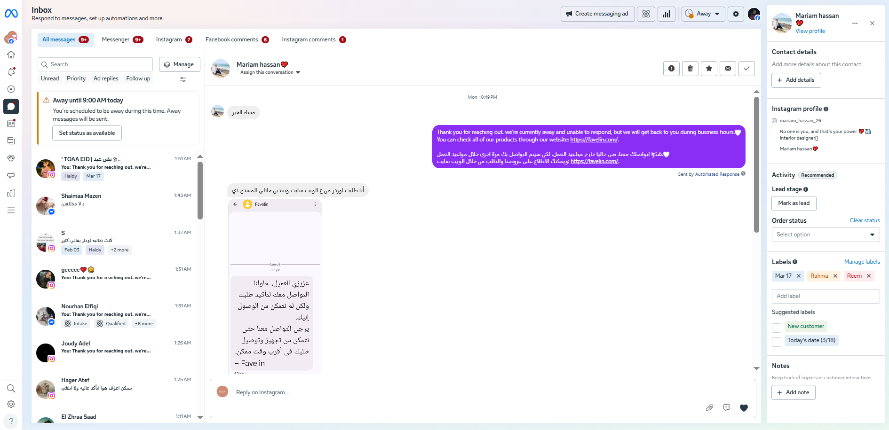
Platform Management: Manage all Favelin social media platforms and communication channels to ensure seamless customer interaction. This includes:
Social Media
Meta Business Suite: Handling all inquiries, messages, and comments across Facebook and Instagram.
TikTok: Managing engagement and responding to community feedback.
Live Chat: Providing real-time support via the Tawk.to platform.
https://dashboard.tawk.to/
Communication Strategy: Our interaction style is strictly defined as "Friendly yet Professional." We aim to build a personal connection with our customers while maintaining the brand's high standards and credibility.

Slide 36
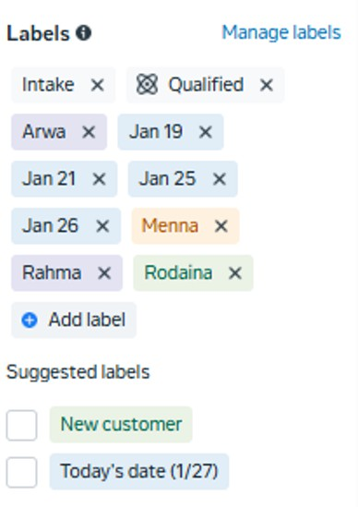
How to reply the messages
1. Queue Management
Priority Routing: Always process from oldest to newest, to ensure timely responses for all customers.
Accountability: Label each ticket or conversation with your name and the current date to maintain clear ownership and tracking.
2. The Communication Flow
Professional Greeting: Begin every interaction with a personalized greeting (e.g., "Dear [Customer Name]").
Comprehensive Support: Ensure all customer questions are answered fully and accurately in a single response.
Personalized Messaging: Avoid over-reliance on templates; use free-text to provide a human, tailored experience when necessary.
Consultative Selling: Recommend products based on the customer’s specific needs or concerns.
Accuracy: Provide precise and up-to-date product information at all times.
Logistics Transparency: Always mention the standard delivery window (within 3-5 working days).
Promotional Clarity: For bundles or special promotions, clearly explain exactly what the offer includes to manage expectations.

Slide 37
Service Recovery & Issue Resolution Guide
Acknowledgment & Apology:
For Delivery Errors: Sincerely apologize for any discrepancies (missing items, extra items, or incorrect products).
For Product Damage: Express regret for any unintentional damage (leaking, broken, or defective products).
The Professional Response (Script):
"We sincerely apologize for this experience. Please be assured that we have officially filed your complaint.
https://docs.google.com/forms/d/e/1FAIpQLSfvkHWyoXGbjb1bC6iIlZr4d_9AhVrzh0PU3QzIEikB5reqIw/viewform
Our specialized team will contact you to resolve this issue during our working hours: Sunday to Thursday, 10:00 AM – 6:00 PM."
Note: File all complaints as B2C using the internal form. Include Order ID, Source, and specific Product details (Size/Line/Scent) that had the issue. Set Normal to most of the customer by default; escalate to Urgent and Top Urgent only for legal threats (Consumer Protection) or severe negative publicity.
3. Issue Resolution & Closing
Delay Protocol: If an order is delayed, sincere apology to the customer. Provide the expected delivery time, the Tracking Number (if the status is "Shipped") and Aramex Hotline 16996.
Closing the Interaction: Close the conversation by either offering assistance with placing the order or wishing the customer a pleasant day.

Slide 38
Customer Interaction Guidelines
If a customer asks about price or product availability → Use Social media sheet Or Saved Replies. Social Media Data Base
If a customer requests product recommendation → suggest based on customer’s need.
If a customer asks about a delayed order → First, we apologize for the delay if the delivery time has been exceeded, then we inform the customer of the order status, the tracking number, and the Aramex customer service number 16996, we can send an email to delivery success team with the delivery speed.
If the customer has a complaint, we apologize to her and submit a complaint through the Complaints Form entering all the details and information accurately. Complain Form , Customer Care Sheet

Slide 39
Additional Sheets we use:
1-Delivery Success Sheet & Form Usage
Delivery Success Form
https://docs.google.com/forms/d/e/1FAIpQLScWnus4unPH_ch31- 2K7LXGvaGKrLsx4UMYSbJNMp_zK9cwEg/viewform
Delivery Success Sheet : https://docs.google.com/spreadsheets/d/1QPS9DgsN7UEevDXWQqEyBWI4nZj4eN7_7V4cHCQBbL0/edit? gid=94389970#gid=94389970
Expediting Orders: To prioritize and speed up the delivery process.
Shipment Cancellation: To stop a shipment that has already been dispatched.
Branch Pickup: When a customer prefers to collect their package directly from an Aramex branch.
Holding Shipments: To request Aramex to hold an order for up to 3 days.
Courier Issues: To report and resolve any problems encountered with the delivery agent.

Slide 40
2-B to B Sheet & Form Usage
B2B Form: https://docs.google.com/forms/u/0/d/e/1FAIpQLSd1Nq9zOzdyoWsdgHIH7Ge9NOXGloOa1sqGh3iif- kgS3C5RA/formResponse
B2B Sheet : https://docs.google.com/spreadsheets/d/13635a8mS8z2YH4OpIQYOYb4vIDkadTfygL23yn8iK28/edit? gid=1631722168#gid=1631722168
The B2B Sheet is designated for handling bulk requests and corporate partnerships, specifically in the following scenarios:
Retail & Pharmacy Supply: When a customer requests to stock our products in their pharmacy or retail store.
Event Planning: When a customer requires a bulk supply of products to be available for a specific event.
Corporate Orders: For handling large-orders requested by companies or organizations.

Slide 41
Online Payment Form: https://docs.google.com/forms/d/e/1FAIpQLSfYy7ET2PnCEPUi87aOS64oiVbz8RmVMs1_J3NLqb5H2pjNFA/ iewform
3- Online payment Sheet & Form Usage
Online Payment Sheet: https://docs.google.com/spreadsheets/d/1rWQW_bShf- pku_PpsopYAiM6_Q_NBUB2Qidfg4Ovk0Y/edit#gid=1440801047
The Online Payment Sheet and Form are used to document and track transactions made via digital wallets or instant payment platforms (InstaPay or Vodafone Cash). This applies to the following cases:
Balance Adjustments (Cases): When there is a price difference or an outstanding balance that the customer needs to settle.
Order Modifications: When a customer has already paid for their order but wishes to add additional items, requiring a supplementary payment.

Slide 42
In summary the agent’s tasks include:
Responding to social media messages Responding to live chat inquiries Confirmation calls
Field payment calls Field delivery calls
Feedback calls (B2C & B2B)
As part of their core responsibilities, agents are required to drive sales to meet a 10% monthly sales target. Achieving this target is a prerequisite for qualifying for the relevant portion of their Key Performance Indicators (KPIs).

Slide 43
Sales Achievement & Tools
Agents are expected to achieve their sales targets through their daily operational tasks, which include:
Inbound & Outbound Communication: Managing messages and handling various call types.
Failed Delivery Follow-up: Converting missed deliveries into successful re-orders.
Customer Feedback Calls: Leveraging feedback sessions to identify upsell or cross-sell opportunities.
Failed Payment Recovery: Assisting customers in completing transactions after payment issues.
Sales Conversion Tool: "WECARE10"
To assist in closing sales and encouraging re-orders during calls, agents are authorized to provide a special discount code: WECARE10.
Discount Value: 10% off the total order value.
Usage Case: This code is specifically used to incentivize customers who require an additional discount to finalize their purchase or commit to a re-order.

Slide 44
Performance Evaluation & KPI Weighting
Daily tasks are integral to the agent's performance evaluation and directly contribute to their Key Performance Indicators (KPIs).
Each task is assigned a specific target and a corresponding weight within the overall KPI score. The final evaluation is determined as follows:
Target Achievement: If an agent meets or exceeds the target for a specific task, they earn its full assigned weight.
Non-Achievement: Failure to meet the task target results in the forfeiture of the weight associated with that specific task.

Slide 45
Team Leader Tasks
Task Delegation: Assign pending orders, feedback, and field delivery/payment tasks to agents.
Performance Monitoring: Oversee daily agent activity, resolve issues, and provide real-time support.
Reporting: Compile the FO Daily Report to document performance and order metrics.
Core Metrics & Reporting
Agent Performance: Track message volume (Delegation Sheet)
https://docs.google.com/spreadsheets/d/1OPEd5gjATZmKhQODxg3U4gCHcmTw8CMYHHGrBSi86fQ/edit?pli=1&gid=0#gid=0
,conversion rates (Social Media Sheet tab Daily Orders)
https://docs.google.com/spreadsheets/d/1h-ERhF1WS51jWdzynfYBbrbz1u6HVCjJnIBydzwQuOI/edit?gid=242582919#gid=242582919 , and response times (Meta).
Order Statistics: Monitor the status (Confirmed, Pending, Canceled) and percentage distribution of all orders.
Delight Messages: Audit deleted messages, open/closed statuses, and response SLAs.

Slide 46
Team Leader Tasks
Daily Tasks:
Assign tasks to agents.
Pull pending orders, feedback, field delivery, and field payment and assign them to agents. Monitor agents’ daily performance and follow up if any issues arise or if anyone needs assistance. Prepare a daily report in FO Daily Report, which includes:
Agent task performance:
Number of messages received and responded to (from the Delegation sheet – Tap Messages Assigned). Conversion rate from the Orders Tab in the Social Media Sheet.
Response time and response messages (data from Meta).
Orders statistics:
Number of confirmed, pending, and canceled orders, and their percentages.
Delight messages:
Number of messages deleted, their status (closed or open), and response time from entry to reply.

Slide 47
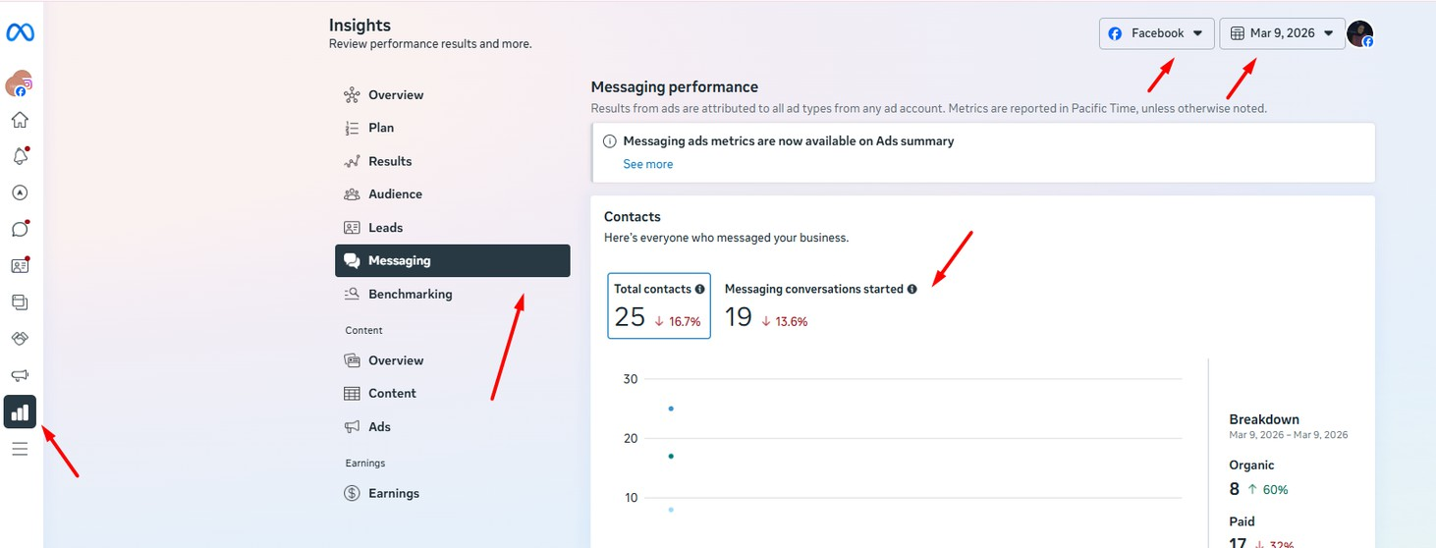
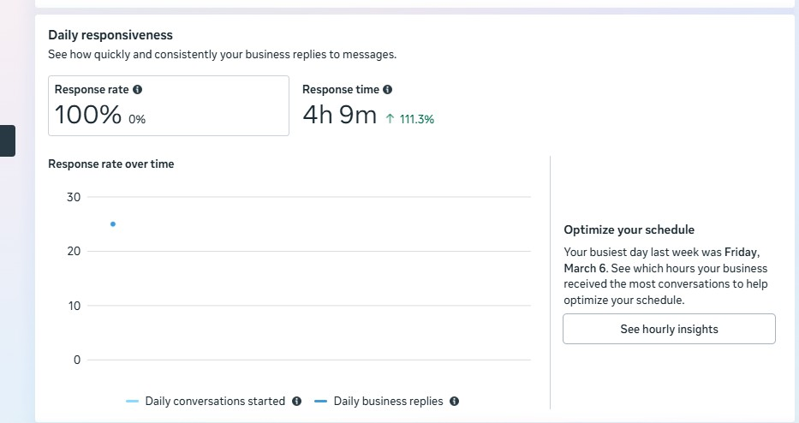
From Meta:

Slide 48
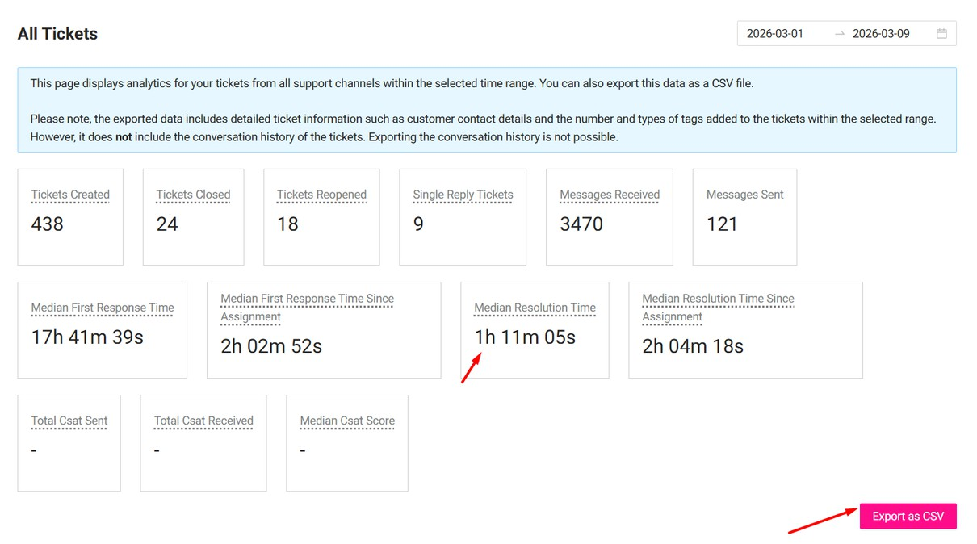
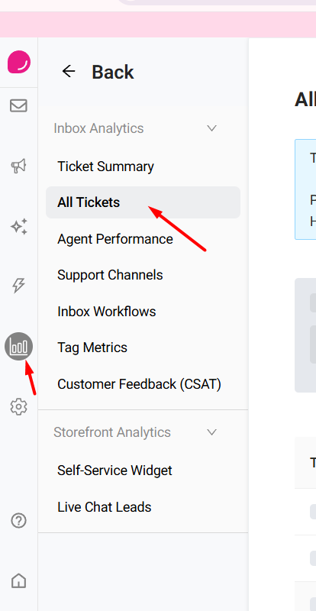
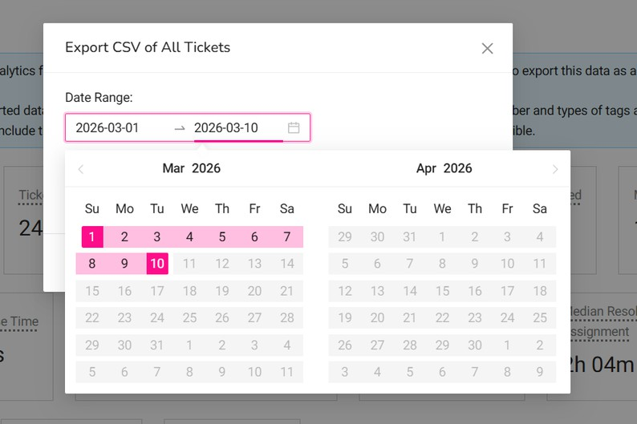
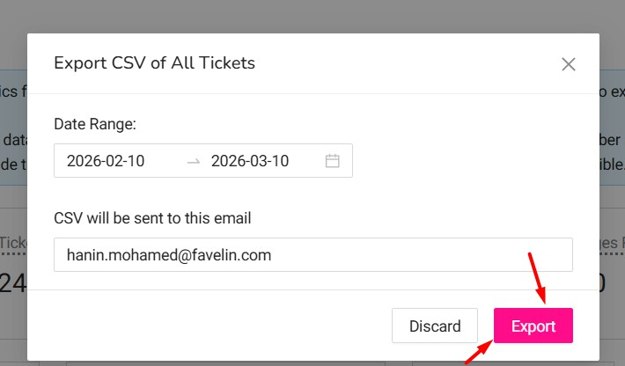
From Delight:
We export the data from Delight, which is received via email, into a sheet and filter by phone number only to determine the total number of messages received on WhatsApp.

Slide 49
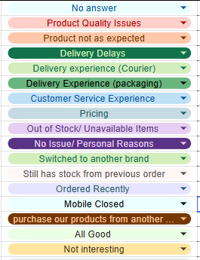
Field Delivery:
From the Pending Orders sheet Field Delivery tab , track how many orders were processed, customer responses, outcomes, and how many customers did not respond.
Field Payment:
From the Pending Orders sheet Field Payment tap, same as field delivery: track customer responses, outcomes.
Feedback:
Process feedback from 40 customers per day, recording the outcome for each customer.

Slide 50
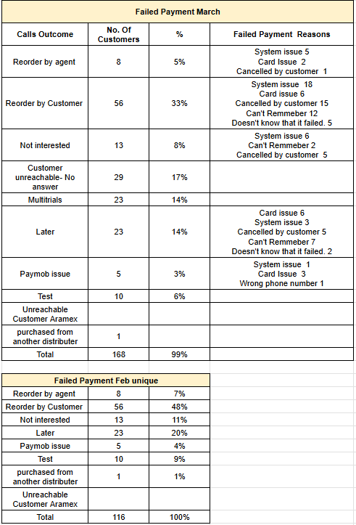

Failed Payment overview
Failed Delivery overview

Slide 51

Overview Feedback

Slide 52
The weekly tasks are similar to the daily tasks, with additional activities:
Every 10 days, we share sales numbers with the agents.
Every 15 days, we hold one-on-one meetings to review performance during the first half of the month.
Monthly Task Overview:
The monthly task involves compiling a report that summarizes all daily tasks performed by agents to evaluate monthly performance and identify any issues for resolution. The report includes:
Social Media Performance:
Number of orders received, confirmed, canceled, or still pending.
Orders with status “closed” and their amounts. Orders canceled by customers and their amounts.
Field Delivery Orders:
Number of orders, amounts, and recoveries (by agent or customer) with amounts.
Field Payment Orders:
Number of orders, amounts, and recoveries with amounts.
Calls Performance:
Number of calls made by each agent and their AHT (Average Handling Time).
Total calls during the month, answered calls, abandoned calls, incoming calls, and their percentages.
All these details are recorded in the sheet for February as an example. CX Feb Report

Slide 53
FO Hierarchy
The FO team currently consists of 9 agents,
FO Team Leader, CX supervisor, CX Manger
➡ Following this hierarchy is mandatory. Skipping steps is not allowed.

Slide 54
Thank you
2026
THANKS FOR READING
Made with FO Team

